Slide 1
ITSC 200 – Network Protocols and Security
Linux

Slide 2
Today’s Objectives
Learn to how check for running daemons
Determine which ports are listening
Check running processes
Find and install additional software
Do updates (actually upgrades) of the system

Slide 3
What is a Daemon
A daemon is a running process that runs in the background regardless whether a user is logged into the computer or not.
Most server services, like web servers and mail servers, run as daemons in UNIX/Linux.
The word comes from the Greeks who thought that we were constantly surrounded by invisible daemons.
The Greeks did not see them as good or bad. Christianity later used the term to denote something evil.

Slide 4
What is a Daemon
Traditionally, the scripts used to start daemons are kept in /etc/init.d and, by convention, end in “d”. This is known as the SystemVinit.
httpd, dhcpd, named, etc.
We then have directories rc?.d under a directory that is either /etc/rc.d/… or /etc/
In Mint Linux we have directories rc0.d, rc1.d, rc2.d and so on.
These directories represent the runlevels in Linux. So runlevel 3 would be in rc3.d.

Slide 5
Runlevels
Traditionally, the way that daemons would be started is that we would create a symbolic link in the rc?.d directory that would point to the script in /etc/init.d
If the name of the symbolic link started with a capital S, then it would start the daemon when the OS entered that runlevel.
If the name of the symbolic link started with a capital K, then it would stop the daemon when the OS entered that runlevel.
The default runlevel was set in the /etc/inittab file.

Slide 6
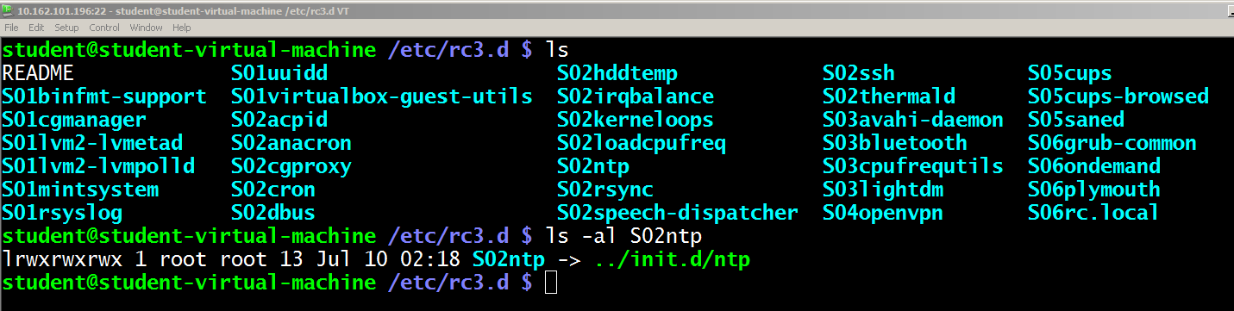
Runlevels

Slide 7
Runlevels
We are in a state of transition now. The SystemV style of starting and stopping daemons and setting runlevels is being phased out in favor of Systemd.
Systemd works on “units”. The normal unit is a “service” (same as a daemon).
We use the systemctl command to manipulate services. The concept of runlevels doesn’t really apply anymore and have been replaced with “targets”

Slide 8
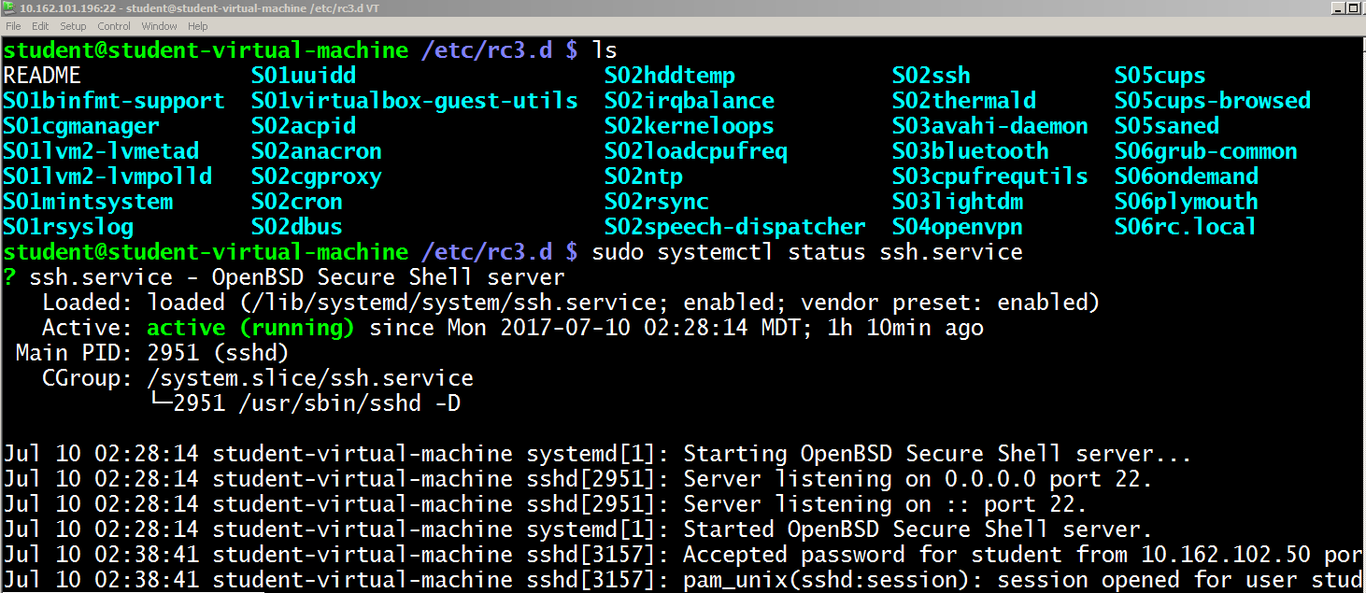
Systemd

Slide 9
Systemd
To start a service (daemon)
sudo systemctl start apache2.service
To stop a service
sudo systemctl stop apache2.service
To restart a service
sudo systemctl restart apache2.service
To make a service start automatically at boot time
sudo systemctl enable apache2.service
I’ll bet you can figure out how to stop it from starting automatically at boot time
We can also use the “status” option to see if it is running or not.

Slide 10
Checking for Listening Ports
Checking for listening ports on your server is important because these are the “doors” to your server.
When a hacker “port scans” our server, that is exactly what they are looking for.
Listening ports can be TCP or UDP. Of course we won’t see connections on a listening UDP port. Why ?

Slide 11
Checking for Listening Ports
We can use the netstat command on Windows or Linux to check listening ports.
Always use the –n option as this will give you the numeric port number. Just because a service is listening on TCP port 80, it doesn’t mean it is a web server.
The only ports we are really interested in (at this point anyway) are the ports that are listening on the NIC IP address, since this is accessible from the outside.

Slide 12
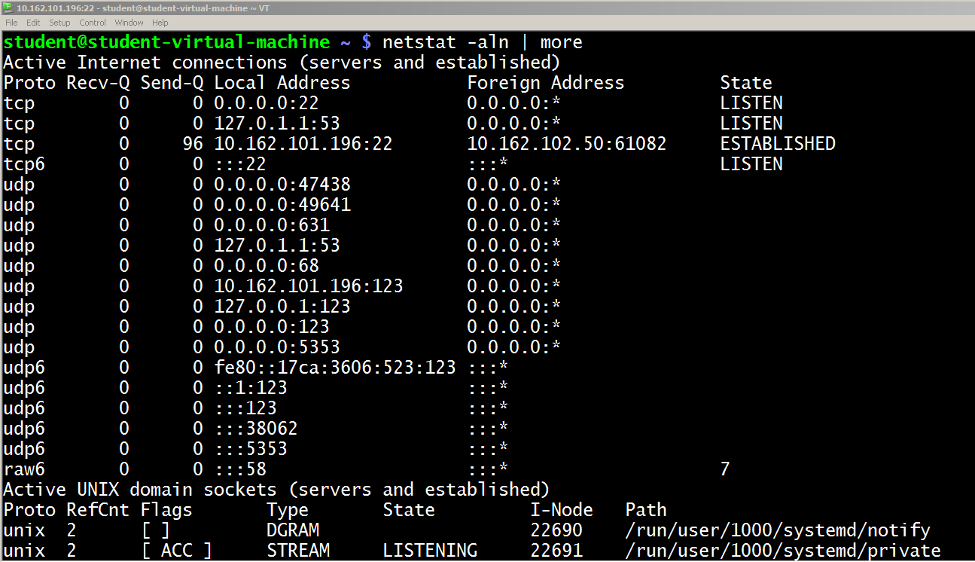
Checking for Listening Ports

Slide 13
Checking Running Processes
There are several ways that we can do this. One of the easiest ways to get a sense of what is happening on the server is to use the top command.
It will run and show you the processes consuming the most system resources until you press ctl-c.
Often it is better to check processes as the root user. The easiest way to do this is to do the sudo su command.

Slide 14
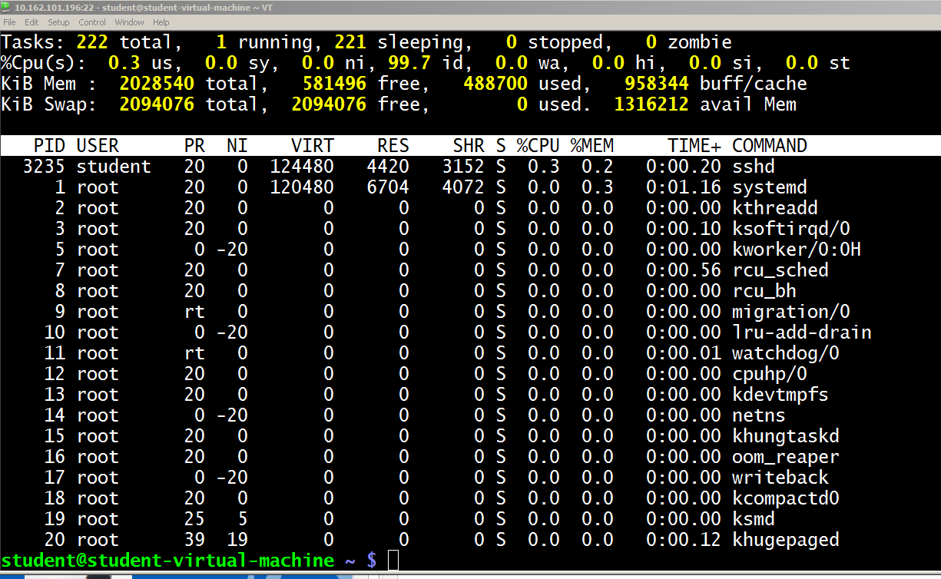
Top

Slide 15
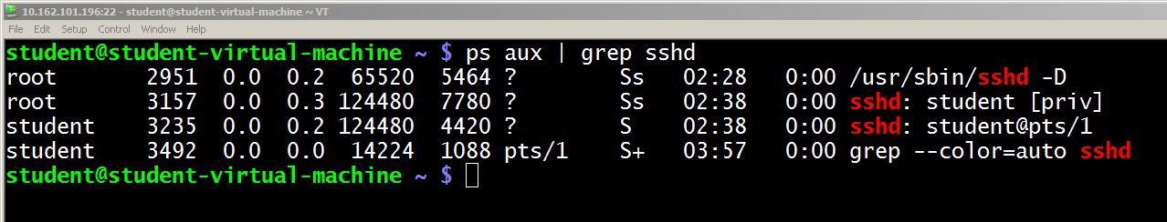
Checking Running Processes
A more common way is to check all running processes with the ps command and pipe it to grep to pull out the process(es) you are looking for.
Of course with grep, we can search for name, process id, process owner, or whatever we want.

Slide 16
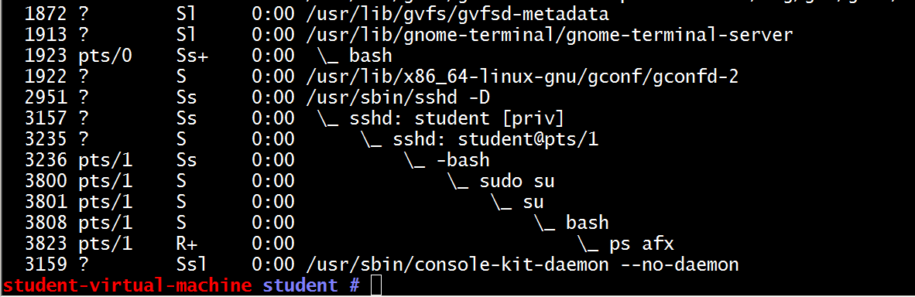
Checking Running Processes
Sometimes you want to see parent and child processes. You can do that with an option of the ps command.
If you do the ps axf (note you do not use -), you will see a “forest” of processes in a parent/child relationship.

Slide 17
Installing Additional Software
This is one area where the Linux distributions diverge from each other.
Basically, almost all Linux distributions derived from three original distributions and these three used their own package managers.
Redhat – uses rpm and, more recently yum
Debian – uses apt
Slackware – the most popular derivative of Slackware is SuSE which uses Yast

Slide 18
Finding Software for Debian-based Distributions
Ubuntu and Mint are both Debian-based distributions and we will look closer at apt.
First, we want to make sure we have an updated, current list of software available.
Then we want to search through the software.
Lets look for wireshark
Note that we should be root for installing software

Slide 19
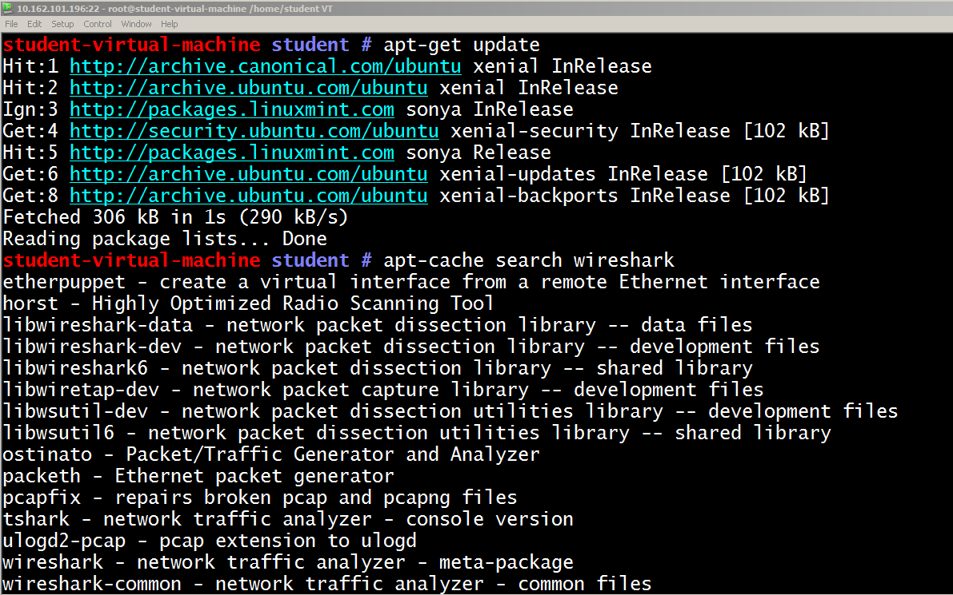
Finding Software for Debian-based Distributions

Slide 20
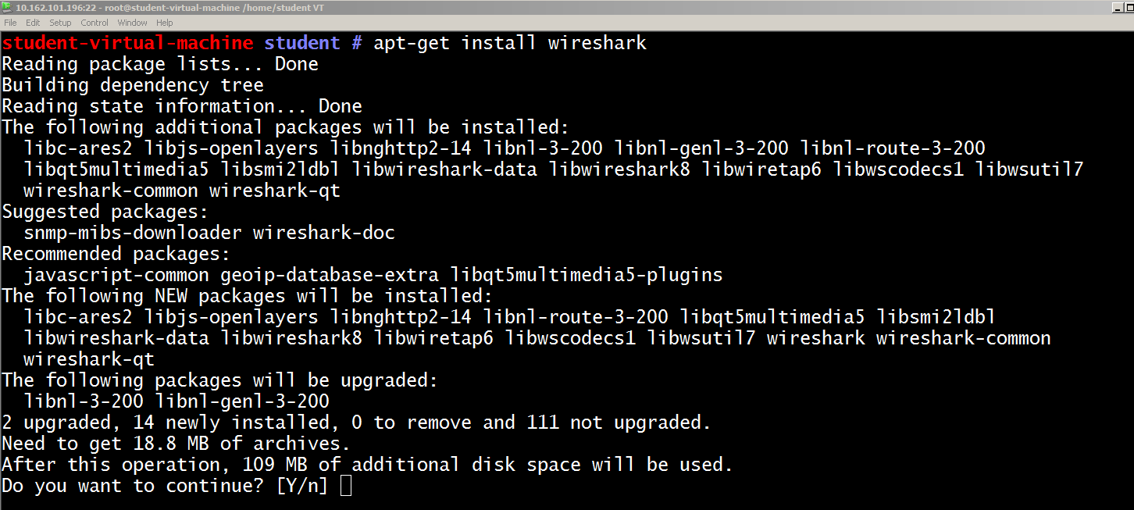
Installing Software for Debian-based Distributions

Slide 21
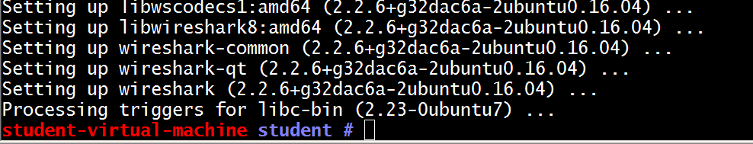
Installing Software for Debian-based Distributions
The apt package manager will find, download, and install the package and all of its dependencies (additional software that the package relies on).

Slide 22
Updating (upgrading) the Operating System
You all know that keeping the operating system up-to-date is one of the best security practices.
With Linux, we can do this with two commands. New versions (online) of software are checked and, if needed, are downloaded and installed.
First we need to have an up-to-date list of software available. We do this with the apt-get update command.
This command updates the LIST of software, not the software.
Secondly, we use the apt-get upgrade command to actually download and install the updated software.

Slide 23
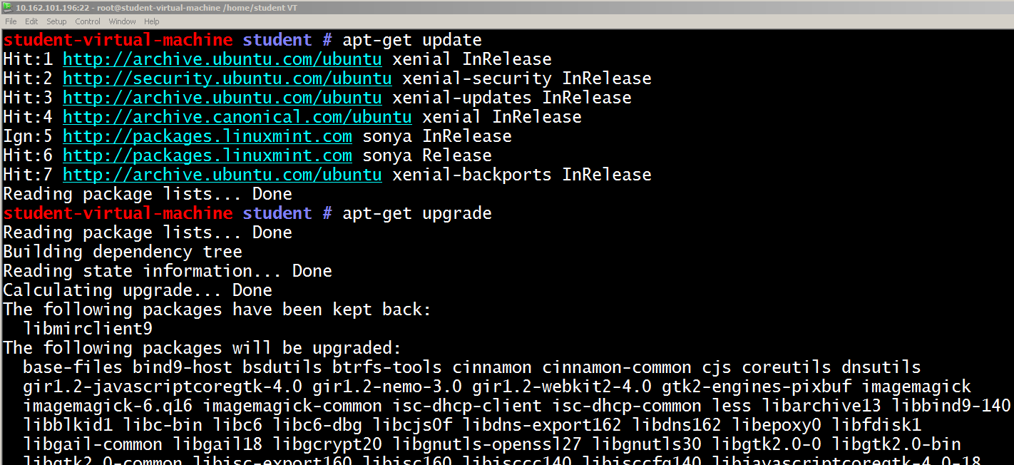
Updating (upgrading) the Operating System

Slide 24
Updating (upgrading) the Operating System
Be aware that the upgrade process can take a long time when you first do it. Do not interrupt it.
Doing an apt-get update then an apt-get upgrade should be the first thing you do after installing a Debian-based distribution.
After completing this the first time, the commands can be run whenever you want. The more frequently you do it, the shorter will be the time to upgrade.

Slide 25

Coffee Break!

Slide 26
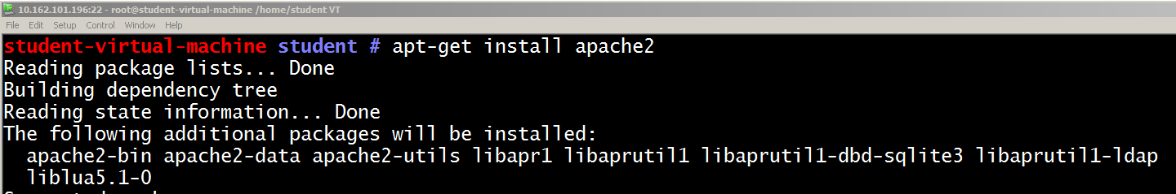
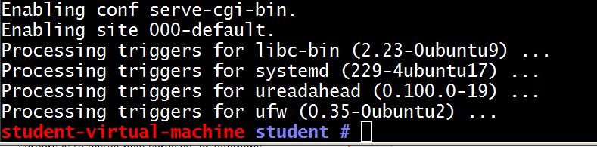
Installing New Daemons
One of the most common things we do with Linux servers is to install new services, or daemons.
To install a web server is a simple, one line command.

Slide 27
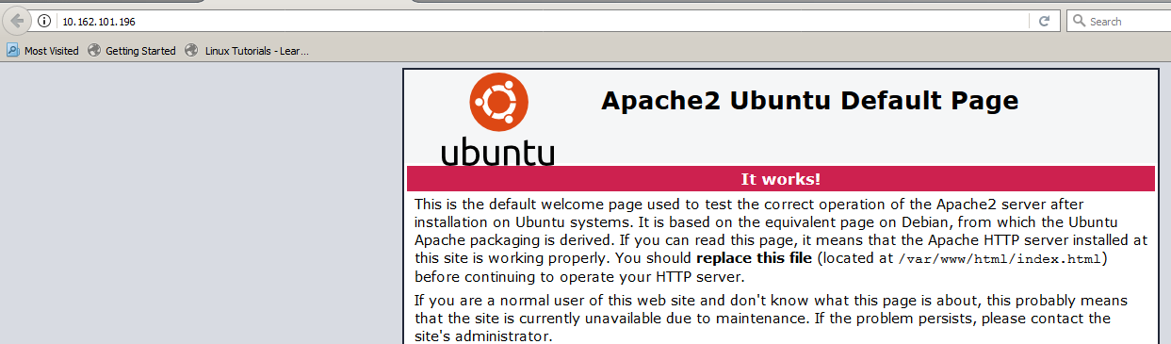
Web Server Installed

Slide 28
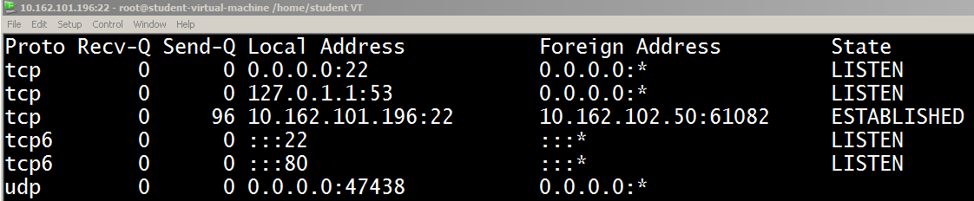
Web Server Installed
The tcp port 80 doesn’t show up because apache2 is designed to listen on all available IP addresses and so only shows tcp6 port 80, even though it is also listening on tcp 80.

Slide 29
Lab 6
Download and complete Lab 6

Slide 30
Done

